Slide 1

LINEAR AND QUADRATIC FUNCTIONS AND ITS GRAPHS

Slide 2
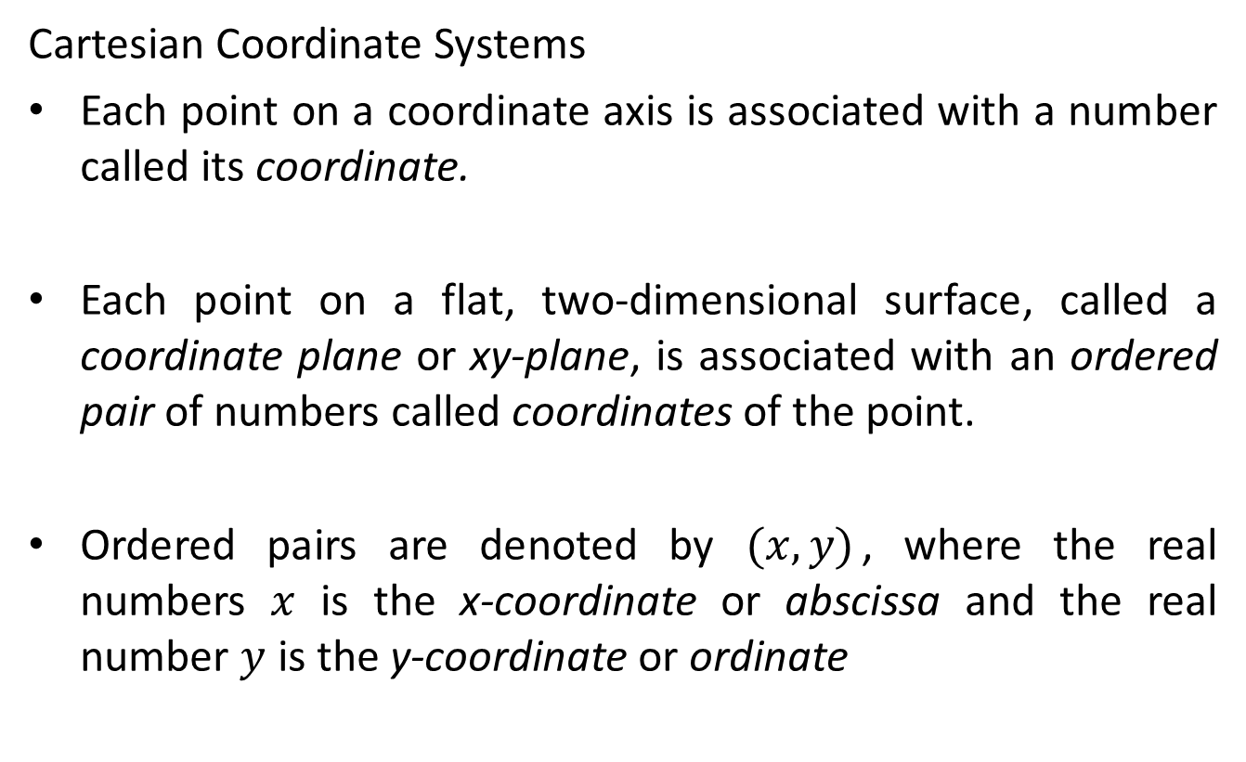
LINEAR FUNCTIONS
Slope of a Line
A function can be written in the form $f\left(x\right)=mx+b$ is called a linear function because its graph is a straight line.
Graphs of linear functions are characterized by having a constant rise or fall. This rise or fall is called slope.
- positive (+) slope, the y-value is increasing as x increases (line inclined to the right).
- negative (-) slope, the y-value is decreasing as x increases (line inclined to the left).

Slide 3
INCLINATION AND SLOPE OF A LINE
The inclination of the line, L, (not parallel to the x-axis) is defined as the smallest positive angle measured from the positive direction of the x-axis or the counterclockwise direction to L.
The slope of the line is defined as the tangent of the angle of inclination.

Slide 4
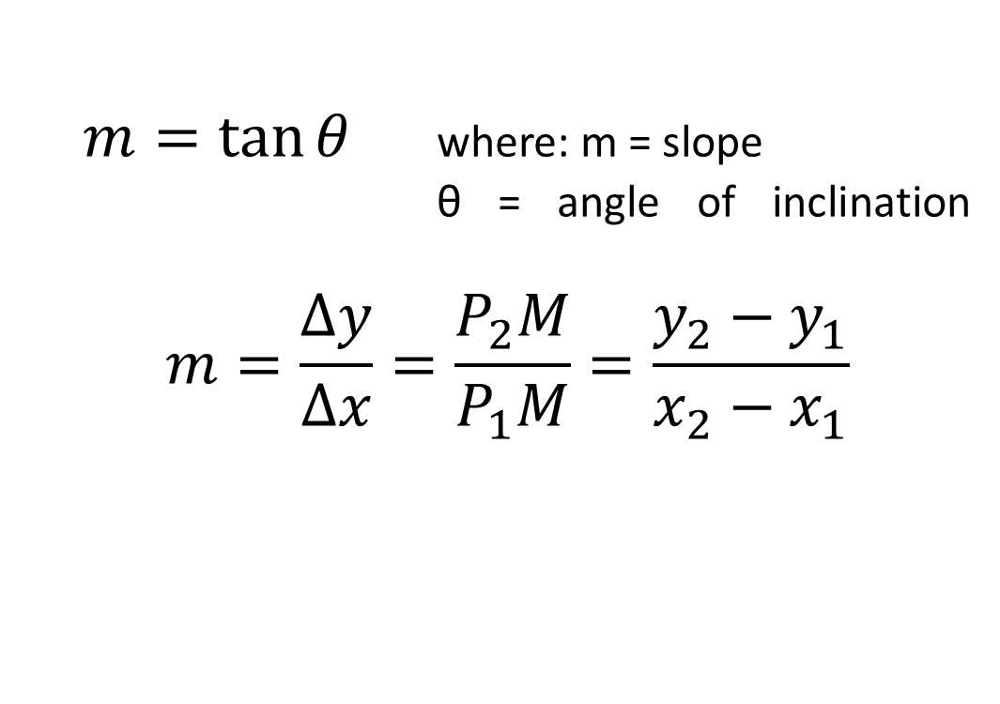

Slide 5
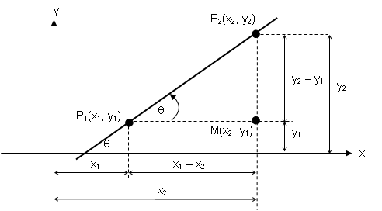

Slide 6
SIGN CONVENTIONS:
Slope is positive (+), if the line is leaning to the right.
Slope is negative (-), if the line is leaning to the left
.
Slope is zero (0), if the line is horizontal.
Slope is undefined ( ), if the line is vertical.

Slide 7
Examples:
1. Find the slope, m, of the lines through each of the following pair of points.
(-8, -4) and (5, 9)
(10, -3) and (14, -7)
(-9, 3) and (2, -4).
2. Find y if the slope of the line segment joining (3, -2) to (4, y) is -3.

Slide 8
STRAIGHT LINES
A straight line is a locus of a point that moves in a plane with constant slope. It may also be referred to simply as a line which contains at least two distinct points.
LINES PARALLEL TO A COORDINATE AXIS
If a straight line is parallel to the y-axis, its equation is
x = k, where k is the directed distance of the line from the y-axis. Similarly, if a line is parallel to the x-axis, its equation is y = k, where k is the directed distance of the line from the x-axis.

Slide 9
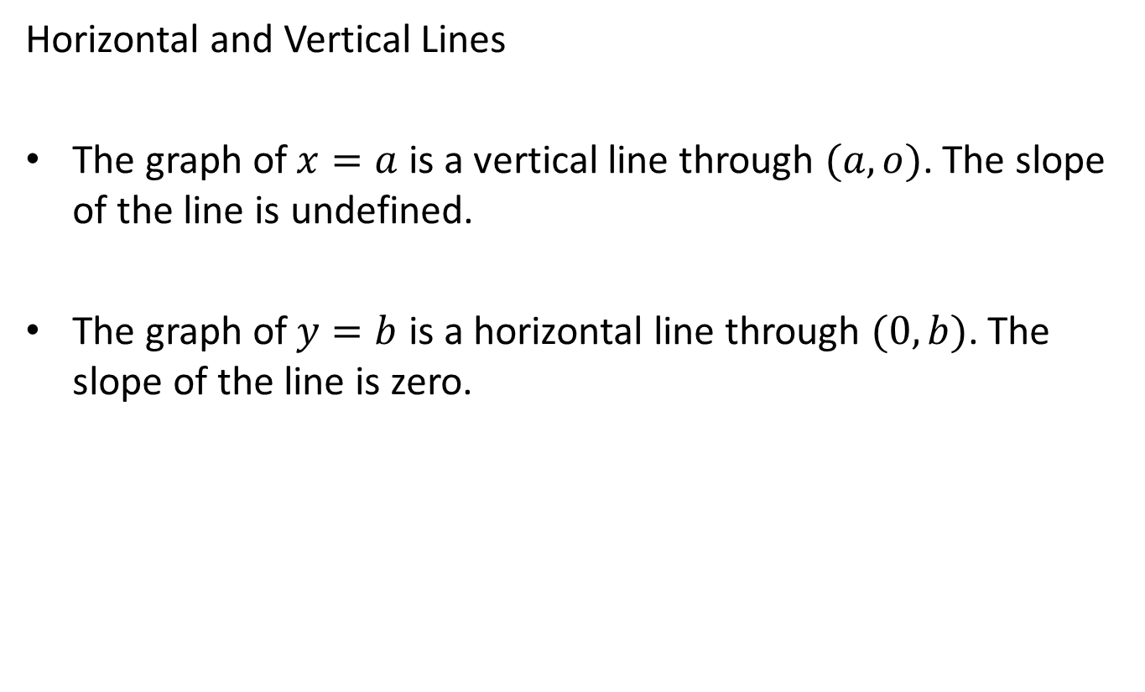

Slide 10
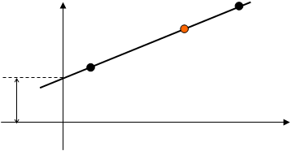

STANDARD EQUATION OF A LINE
SLOPE-INTERCEPT FORM
the graph of $f\left(x\right)=mx+b$ is a line with slope $m$ and y-intercept $(0, b)$
y
P (x, y)
m
B (0, b)
b
x

Slide 11
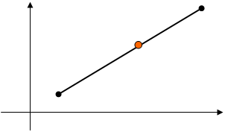



POINT-SLOPE FORM
The graph of ${y−y}_{1}=m({x−x}_{1})$ is a line that has slope $m$, and passes through ($x_{1}, y_{1})$.
y
x

Slide 12

INTERCEPT FORM
The graph of $\frac{x}{a}+\frac{y}{b}=1$ is a line that passes through the points $\left(a, 0\right)$ and $(0, b)$
$a$ is the x – intercept while $b$ is the y - intercept
y
B (0, b)
b - y
P (x, y)
b
y
A (a, 0)
x
x
a - x
a

Slide 13
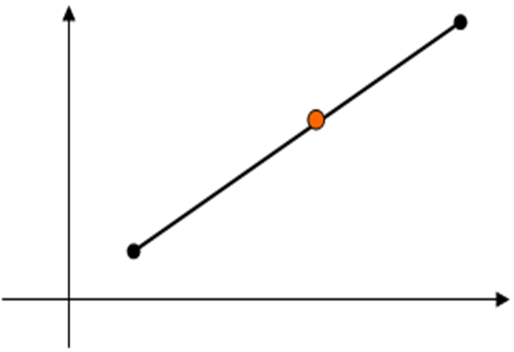

TWO-POINT FORM
The graph of ${y−y}_{1}=\frac{y_{2}−y_{1}}{x_{2}−x_{1}}{(x−x}_{1})$ is a line passes through $P_{1}(x_{1}, y_{1})$ and $P_{2}(x_{2}, y_{2})$.
P₂(x₂, y₂)
y
P (x, y)
P₁(x₁ , y₁ )
x

Slide 14
EXAMPLES:
Find the general equation of the line:
through (2, -7) with slope 2/5
with slope 3 and y-intercept 2/3
passing through (4, -5) and (-6, 3)
with x-intercept of 4 and y-intercept of -6
with slope 1/3 and passing through (5, -3)
passing through (-2, -7) and has its intercepts numerically equal but of opposite signs

Slide 15
QUADRATIC FUNCTIONS
Definition of a Quadratic Function
A quadratic function of x is a function that can be represented by an equation of the form
f (x) = ax² + bx + c
Where a, b, and c are real numbers and a ≠ 0.
Example
f (x) = 2x² – 3x + 1
g(x) = –x² – 5
h(x) = x² + 5x
a = 2, b = –3, c = 1
a = –1, b = 0, c = –5
a = 1, b = 5, c = 0

Slide 16
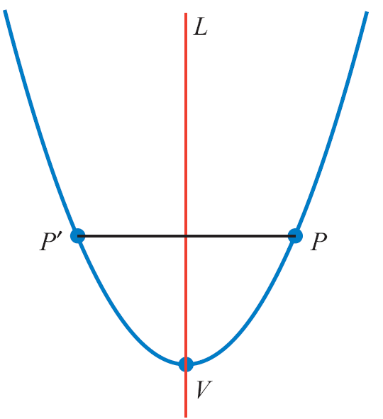
The graph of f (x) = ax² + bx + c is a parabola.
The graph opens up if a > 0, and it opens down if a < 0.
The vertex of a parabola is the lowest point on a parabola that opens up or the highest point on a parabola that opens down.
Point V is the vertex of the parabola in Figure 2.52.
The graph of f (x) = ax² + bx + c is symmetric with respect to a vertical line through its vertex.
Figure 2.52

Slide 17
Quadratic Functions
Definition of Symmetry with Respect to a Line
A graph is symmetric with respect to a line L if for each point P on the graph there is a point P ′ on the graph such that the line L is the perpendicular bisector of the line segment PP ′.
In Figure 2.52, the parabola is symmetric with respect to the line L. The line L is called the axis of symmetry.
The points P and P ′ are reflections, or images of each other, with respect to the axis of symmetry.

Slide 18
Quadratic Functions
If b = 0 and c = 0, then f (x) = ax² + bx + c simplifies to
f (x) = ax².
The graph of f (x) = ax² (a ≠ 0) is a parabola with vertex at
the origin, and the y-axis is its axis of symmetry.
The graph of f (x) = ax² can be constructed by plotting a few
points and drawing a smooth curve that passes through
these points, with the origin as the vertex and the y-axis as
the axis of symmetry.

Slide 19
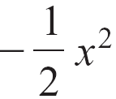
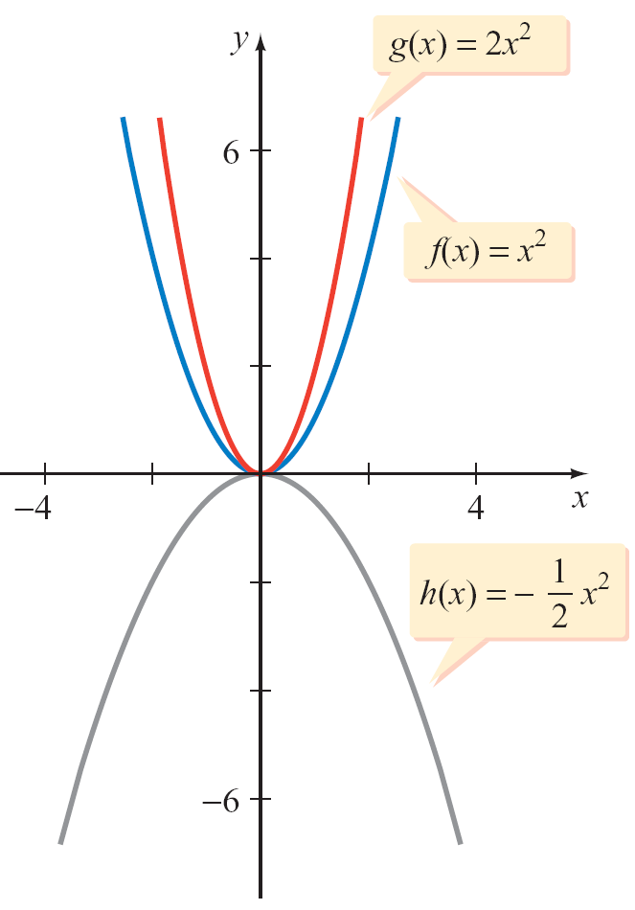
The graphs of f (x) = x², g(x) = 2x², and h(x) =
are shown in Figure 2.53.
Figure 2.53

Slide 20
Standard Form of a Quadratic Function
Every quadratic function f given by f (x) = ax² + bx + c can be written in the standard form of a quadratic function,
f (x) = a(x – h)² + k, a ≠ 0
The graph of f is a parabola with vertex (h, k).
The parabola opens up if a > 0, and it opens down if a < 0.
The vertical line x = h is the axis of symmetry of the parabola.

Slide 21
Quadratic Functions
Example
f (x) = (x – 3)² – 4
f (x) = –2(x + 1)² + 1
a = 1 > 0; parabola opens up
Vertex (3, – 4); axis of symmetry x = 3
a = –2 < 0; parabola opens down
Vertex (–1, 1); axis of symmetry x = –1

Slide 22
Example 1 – Find the Standard Form of a Quadratic Function
Use the technique of completing the square to find the standard form of g(x) = 2x² – 12x + 19. Sketch the graph.
Solution:
g(x) = 2x² – 12x + 19
= 2(x² – 6x) + 19
= 2(x² – 6x + 9 – 9) + 19
= 2(x² – 6x + 9) – 2(9) + 19
Factor 2 from the variable terms.
Complete the square.
Regroup.

Slide 23
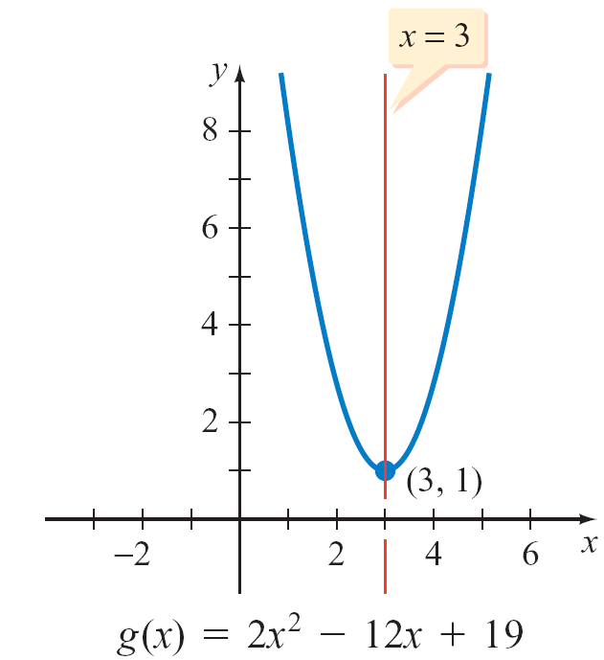
cont’d
Factor and simplify.
= 2(x – 3)² – 18 + 19
= 2(x – 3)² + 1
The vertex is (3, 1). The axis of symmetry is x = 3.
Because a > 0, the parabola opens up. See Figure 2.54.
Use standard form.
Figure 2.54

Slide 24
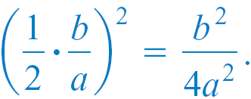
VERTEX OF A PARABOLA
We can write f (x) = ax² + bx + c in standard form by completing the square of ax² + bx + c.
This will allow us to derive a general expression for the x- and y-coordinates of the graph of f (x) = ax² + bx + c.
f (x) = ax² + bx + c
Factor a from ax² + bx.
Complete the square by adding and subtracting

Slide 25
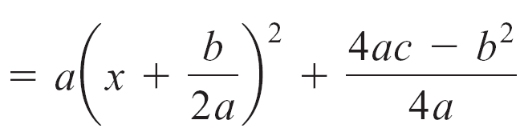
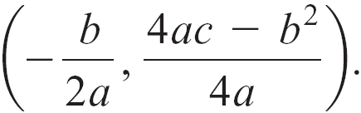
Thus f (x) = ax² + bx + c written in standard form is
f (x) .
Comparing this last expression with f (x) = a(x – h)² + k, we
see that the coordinates of the vertex are
Factor and simplify.

Slide 26
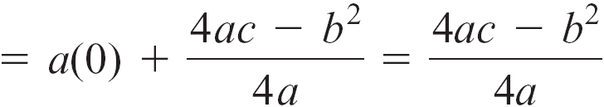
Note that by evaluating
f (x) at we have
That is, the y-coordinate of the vertex is

Slide 27
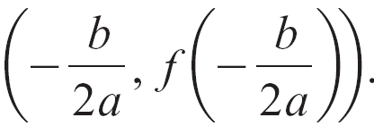
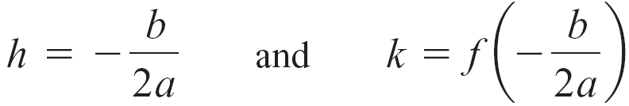
This result is summarized by the following formula.
Vertex Formula
The coordinates of the vertex of f (x) = ax² + bx + c are
The vertex formula can be used to write the standard form of the equation of a parabola.
We have

Slide 28
Example 2 – Find the Vertex and Standard Form of a Quadratic Function
Use the vertex formula to find the vertex and standard form
of f (x) = 2x² – 8x + 3.
Solution:
f (x) = 2x² – 8x + 3
a = 2, b = –8, c = 3
x-coordinate of the vertex
y-coordinate of the vertex

Slide 29
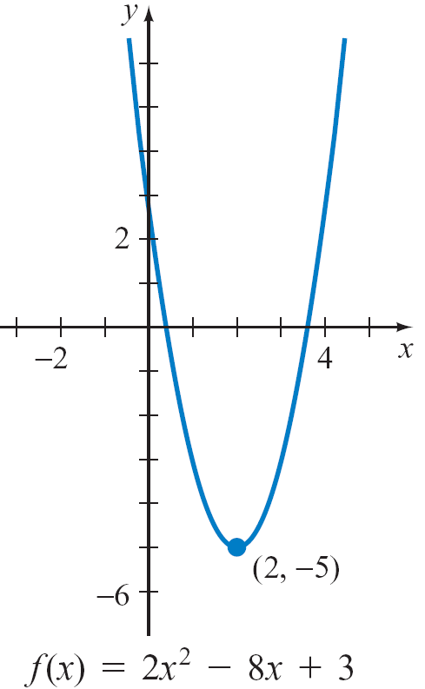
cont’d
The vertex is (2, –5).
Substituting into the standard form equation
f (x) = a(x – h)² + k yields the standard form
f (x) = 2(x – 2)² – 5.
The graph of f is shown in Figure 2.55.
Figure 2.55

Slide 30
MAXIMUM AND MINIMUM OF A QUADRATIC FUNCTION
Note from Example 2 that the graph of the parabola opens
up and the vertex is the lowest point on the graph of the
parabola. Therefore, the y-coordinate of the vertex is the
minimum value of that function.
This information can be used to determine the range of
f (x) = 2x² – 8x + 3. The range is {y | y ≥ – 5}.
Similarly, if the graph of a parabola opened down, the
vertex would be the highest point on the graph and the
y-coordinate of the vertex would be the maximum value of
the function.

Slide 31
For instance, the maximum value of f (x) = –x² + 4x – 1,
graphed as below, is 3, the y-coordinate of the vertex.
The range of the function is {y | y ≤ 3}.
For the function in Example 2
and the function whose graph
is shown at the right, the
domain is the set of real numbers.

Slide 32
The following theorem can be used to determine the
maximum value or the minimum value of a quadratic
function.
Maximum or Minimum Value of a Quadratic Function
If a > 0, then the vertex (h, k) is the
lowest point on the graph of
f (x) = a(x – h)² + k and the
y-coordinate k of the vertex is
the minimum value of the function f.
See Figure 2.56a.
k is the minimum value of f
Figure 2.56a

Slide 33
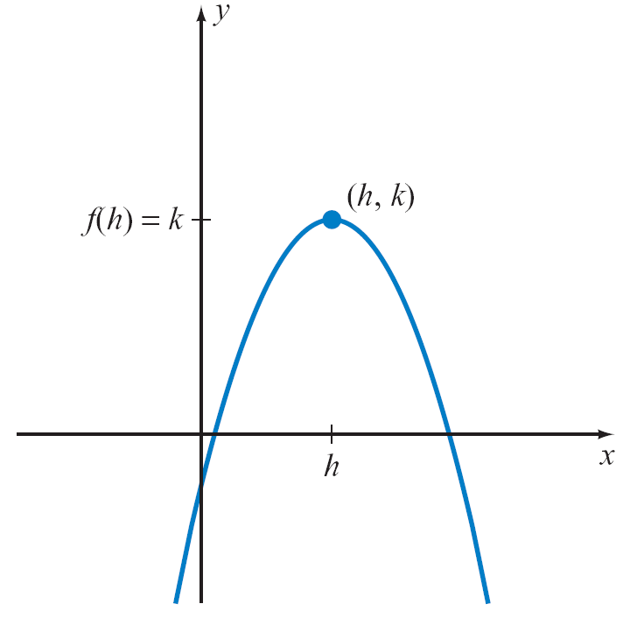
If a < 0, then the vertex (h, k) is the highest point on the
graph of f (x) = a(x – h)² + k and the y-coordinate k is the
maximum value of the function f.
See Figure 2.56b.
In either case, the maximum or
minimum value is achieved when
x = h.
k is the maximum value of f
Figure 2.56b

Slide 34
Example 4 – Find the Maximum or Minimum of a Quadratic Function
Find the maximum or minimum value of each quadratic function. State whether the value is a maximum or a minimum.
a. F(x) = –2x² + 8x – 1
b. G(x) = x² – 3x + 1
Solution:
The maximum or minimum value of a quadratic function is the y-coordinate of the vertex of the graph of the function.
a.
x-coordinate of the vertex

Slide 35
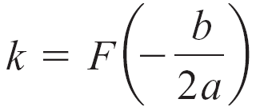

cont’d
Because a < 0, the function has a maximum value but no minimum value. The maximum value is 7.
See Figure 2.57.
y-coordinate of the vertex
Figure 2.57

Slide 36
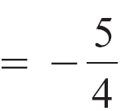
cont’d
x-coordinate of the vertex
b.
Because a > 0, the function has a minimum value but no maximum value.
The minimum value is
See Figure 2.58.
y-coordinate of the vertex
Figure 2.58

Slide 37
SUMMARY

Slide 38
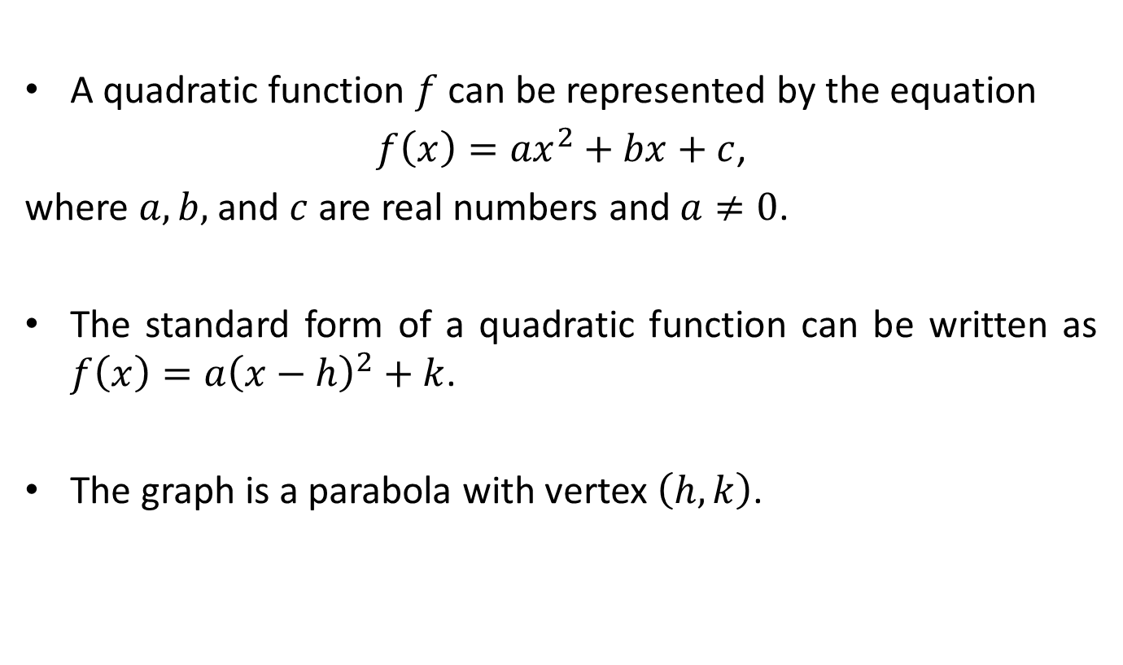
QUADRATIC FUNCTIONS
A quadratic function $f$ can be represented by the equation
$f\left(x\right)={ax}^{2}+bx+c$,
where $a, b,$ and $c$ are real numbers and $a≠0$.
The standard form of a quadratic function can be written as $f\left(x\right)={a\left(x−h\right)}^{2}+k$.
The graph is a parabola with vertex $\left(h, k\right)$.

Slide 39
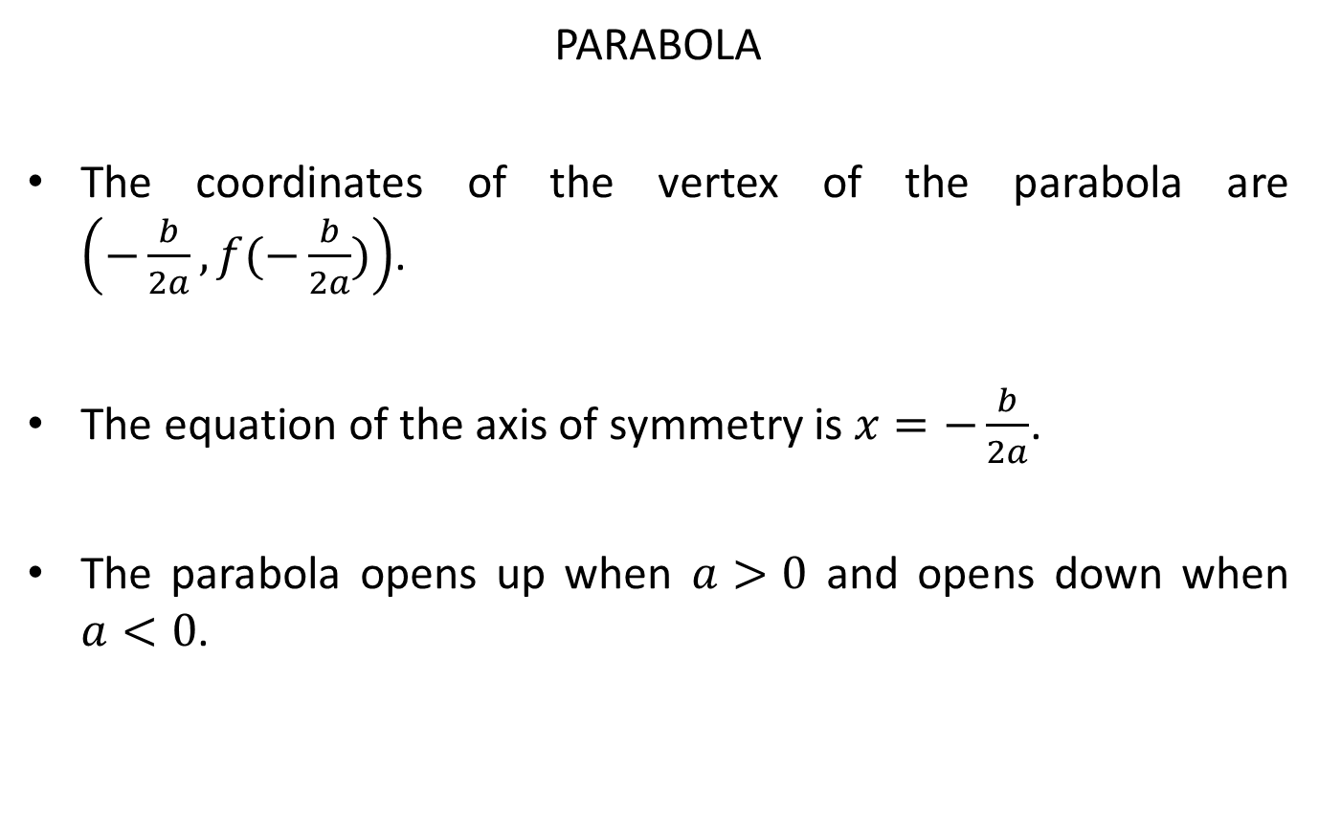
PARABOLA
The coordinates of the vertex of the parabola are $\left(−\frac{b}{2a}, f(−\frac{b}{2a})\right)$.
The equation of the axis of symmetry is $x=−\frac{b}{2a}$.
The parabola opens up when $a>0$ and opens down when $a<0$.

Slide 40
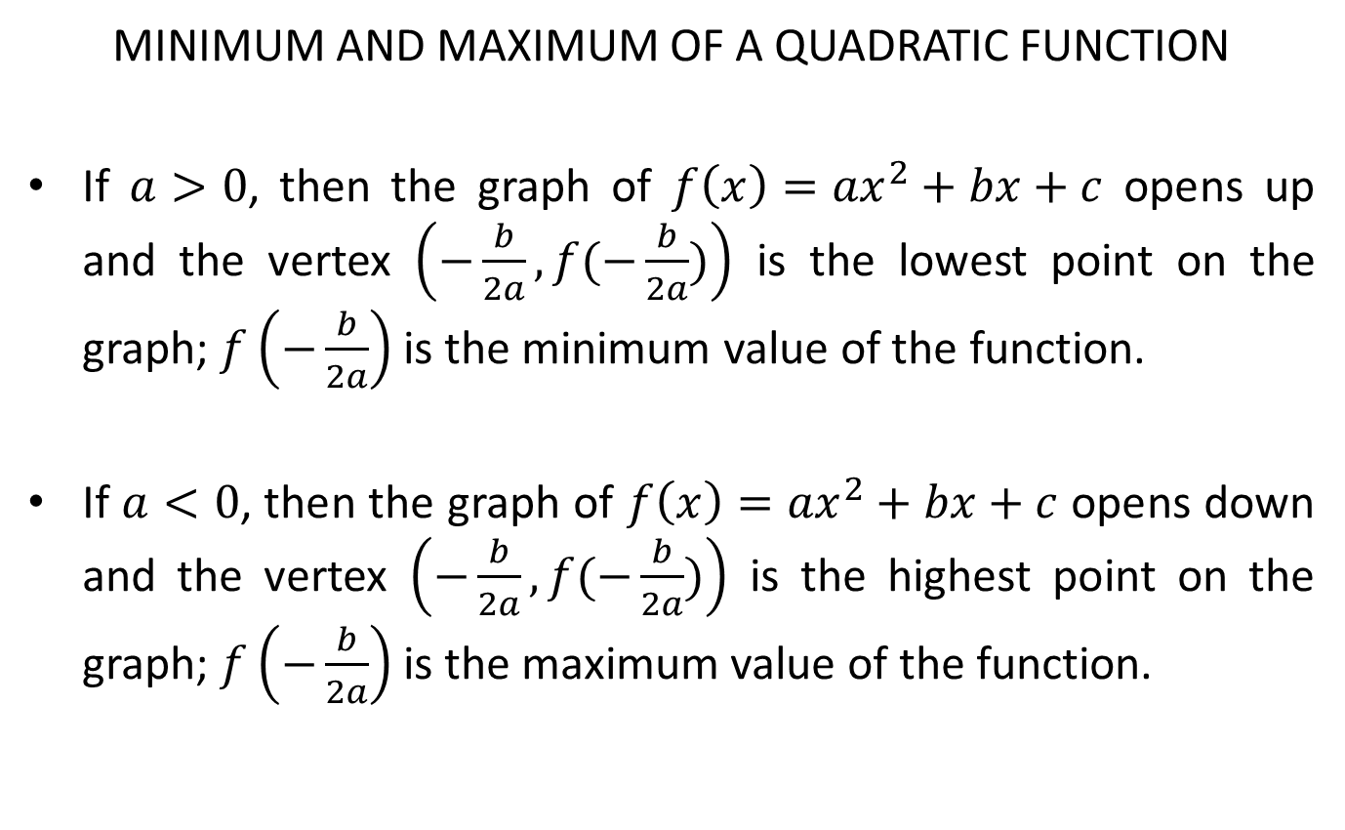
MINIMUM AND MAXIMUM OF A QUADRATIC FUNCTION
If $a>0$, then the graph of ${f\left(x\right)=ax}^{2}+bx+c$ opens up and the vertex $\left(−\frac{b}{2a}, f(−\frac{b}{2a})\right)$ is the lowest point on the graph; $f\left(−\frac{b}{2a}\right)$ is the minimum value of the function.
If $a<0$, then the graph of ${f\left(x\right)=ax}^{2}+bx+c$ opens down and the vertex $\left(−\frac{b}{2a}, f(−\frac{b}{2a})\right)$ is the highest point on the graph; $f\left(−\frac{b}{2a}\right)$ is the maximum value of the function.

Slide 41
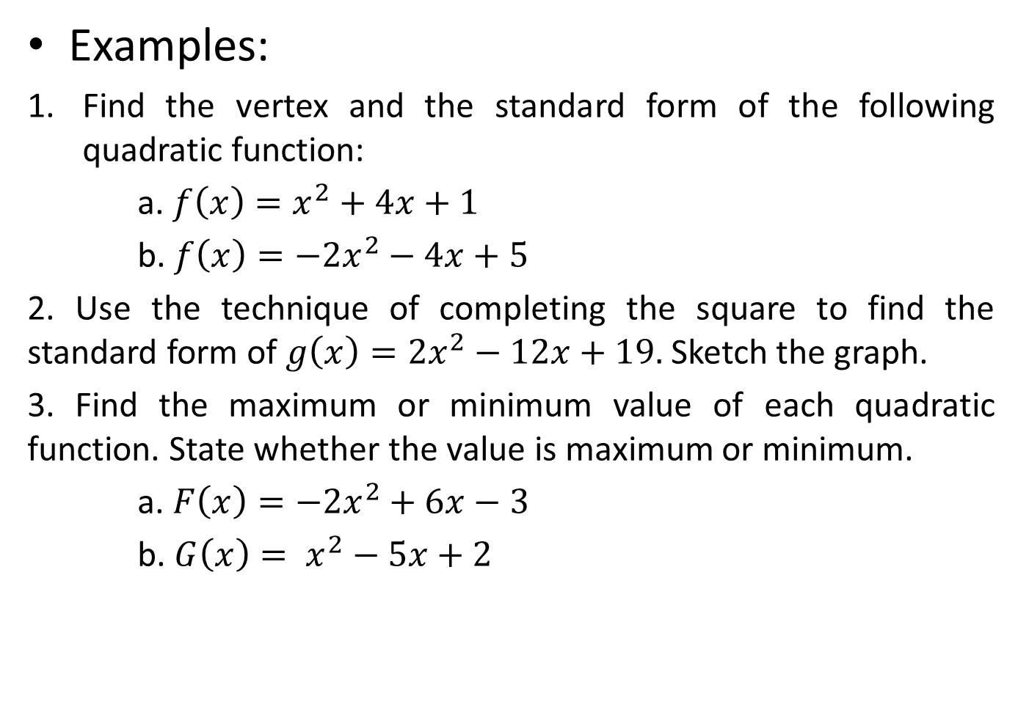

Slide 42
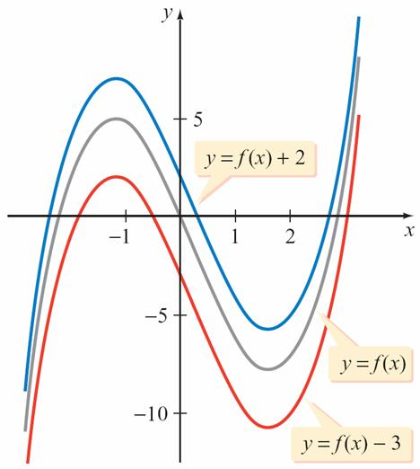
TRANSLATIONS OF GRAPHS
The shape of a graph may be exactly the same as the shape of another graph; only their positions in the xy-plane may differ.
For example, the graph of y = f (x) + 2 is the graph of y = f (x) with each point moved up vertically 2 units.
The graph of y = f (x) – 3 is the graph of y = f (x) with each point moved down vertically 3 units. See Figure 2.77.
Figure 2.77

Slide 43
Translations of Graphs
The graphs of y = f (x) + 2 and y = f (x) – 3 in Figure 2.77 are called vertical translations of the graph of y = f (x).
Vertical Translation of a Graph
If f is a function and c is a positive constant, then the graph of
y = f (x) + c is a vertical shift c units upward of the graph of y = f (x).
y = f (x) – c is a vertical shift c units downward of the graph of y = f (x).

Slide 44
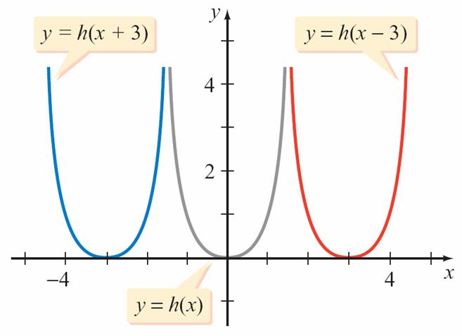
In Figure 2.78, the graph of y = h(x + 3) is the graph of y = h(x) with each point shifted to the left horizontally 3 units.
Similarly, the graph of y = h(x – 3) is the graph of y = h(x) with each point shifted to the right horizontally 3 units.
Figure 2.78

Slide 45
The graphs of y = h(x + 3) and y = h(x – 3) in Figure 2.78 are called horizontal translations of the graph of y = h(x).
Horizontal Translation of a Graph
If f is a function and c is a positive constant, then the graph of
y = f (x + c) is a horizontal shift c units to the left of the graph of y = f (x).
y = f (x – c) is a horizontal shift c units to the right of the graph of y = f (x).

Slide 46
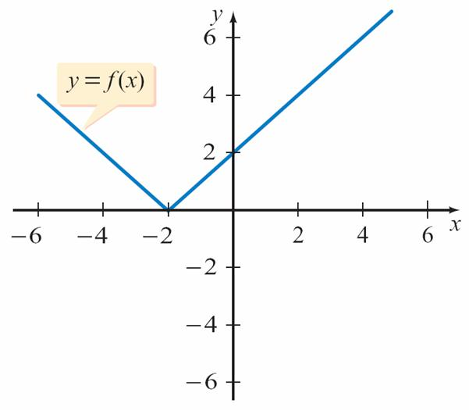
Example 6 – Graph a Function Using a Horizontal and a Vertical Translation
Given the graph of f in Figure 2.85, sketch a graph of
g(x) = f (x + 1) – 3.
Figure 2.85

Slide 47
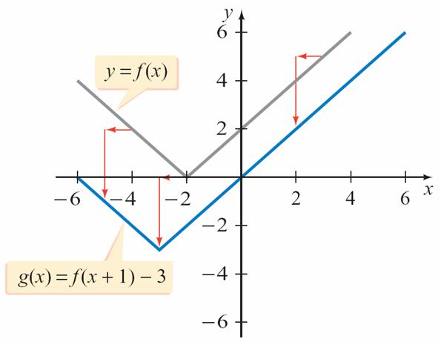
Example 6 – Solution
cont’d
The graph of g is a horizontal shift 1 unit to the left and a vertical shift 3 units down of the graph of f as shown in Figure 2.86.
Figure 2.86

Slide 48
Even and Odd Functions

Slide 49
EVEN AND ODD FUNCTIONS
Some functions are classified as either even or odd.
Definition of Even and Odd Functions
The function f is an even function if
f (–x) = f (x) for all x in the domain of f
The function f is an odd function if
f (–x) = –f (x) for all x in the domain of f

Slide 50
Determine whether each function is even, odd, or neither.
a. f (x) = x³ b. F(x) = | x | c. h(x) = x⁴ + 2x
Solution:
Replace x with –x and simplify.
a. f (x) = (–x)³
Because f (–x) = –f (x), this function is an odd function.
b. F(–x) = | –x |
Because F(–x) = F(x), this function is an even function.
= –x³
= –(x³)
= –f (x)
= | x |
= F(x)

Slide 51
cont’d
c. h(–x) = (–x)⁴ + 2(–x)
This function is neither an even nor an odd function because h(–x) = x⁴ – 2x
which is not equal to either h(x) or –h(x).
= x⁴ – 2x

Slide 52
The following properties are results of the tests for symmetry:
The graph of an even function is symmetric with respect to the y-axis.
The graph of an odd function is symmetric with respect to the origin.

Slide 53
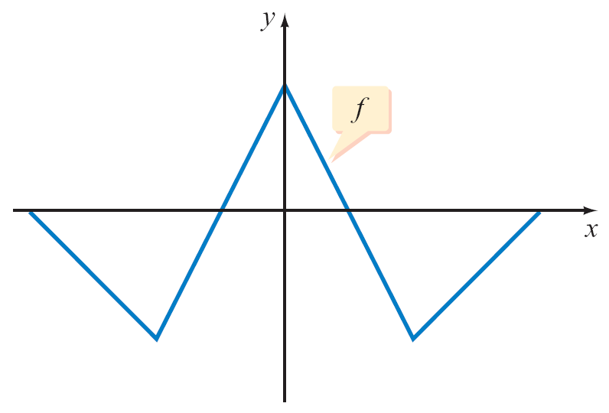
The graph of f in Figure 2.74 is symmetric with respect to the y-axis. It is the graph of an even function.
The graph of g in Figure 2.75 is symmetric with respect to the origin. It is the graph of an odd function.
The graph of an even function is symmetric with respect to the y-axis.
Figure 2.74
The graph of an odd function is symmetric with respect to the origin.
Figure 2.75

Slide 54
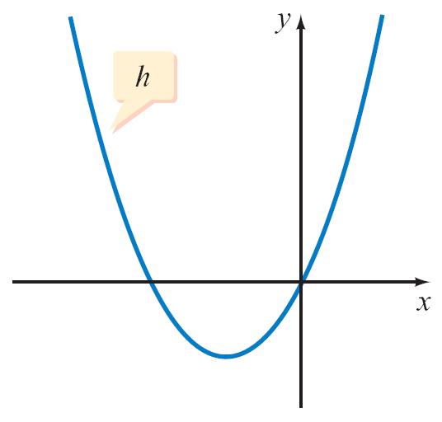
Even and Odd Functions
The graph of h in Figure 2.76 is not symmetric with respect to the y-axis and is not symmetric with respect to the origin. It is neither an even nor an odd function.
The graph of a function that is neither even nor odd is not symmetric with respect to the y-axis or the origin.
Figure 2.76

